Slide 1
L'approche actionnelle? Where do I start?
B5

Slide 2
What is l’approche actionnelle?
The “action-oriented approach” focuses on learning functional language related to accomplishing real-life tasks. This approach views students as “social agents” who use “acts of speech” to interact with others in order to complete tasks that involve a “purposeful action … to achieve a given result in the context of a problem to be solved, an obligation to fulfil or an objective to be achieved” (CEFR, 2001, p. 10).

Slide 3
Putting it into practice…
Setting the stage
Scaffolding learning
Action-oriented learning
Assessment and evaluation
http://www.curriculum.org/storage/30/1370607618/FSL-module-3.pdf

Slide 4
Providing an authentic social context
What do our students like to do?

Slide 5
Step 1
Setting the stage

Slide 6
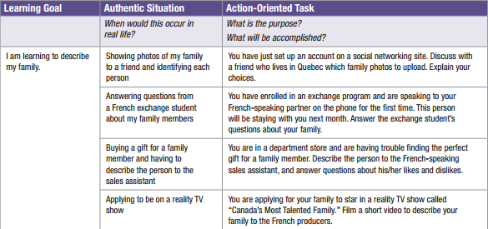
A Guide to Reflective Practice
for Core French Teachers : Module 3 The Action-Oriented Approach

Slide 7
What are some other authentic situations our students might find themselves in.
Think, pair, share

Slide 8
Learning goal | Authentic situation | Action-oriented task

Slide 9
My students
Watch television and movies.
Play video games.
Use social media and their cell phones.
Read.
Hang out with friends
Eat
Travel.
Get a better job.
Make friends.
Understand books and movies in French.
Like to….
Want to learn French to….

Slide 10
Course outline for next year?
Unit 1: Moi_“Super-star”
Ex: Fill out a form, talk about yourself, your interests, your personality and your family and friends, fill out a social media profile.
Unit 2: Mon voyage: J’explore le monde francophone
Plan a trip, go shopping, to a restaurant, write an email and make a phone call to a friend.
Unit 3: Mon emploi à mi-temps
Write a letter, go through a simple interview, make a formal phone call.

Slide 11
Mon voyage (beta mode)
The students plan a trip to a francophone city.
The unit follows what they would do from booking a ticket, to being on the plane, to exploring the city, dining and writing emails and postcards.
Includes grammar points from current grade 9 curriculum (for now).

Slide 12
Step 2
Scaffolding learning and gradual release.

Slide 13
“It is important to note that adopting an action-oriented approach does not mean abandoning presentations and dialogues that have been a part of the communicative approach. These activities are a critical part of the scaffolding and practice that is necessary to enable students to acquire new vocabulary and facility with the language”.

Slide 14
Learning goal: Order at a restaurant
Scaffold learning:
Vocabulary/structure development
Practice together
Repetition.
Gradual release
Dialogue(s)
Info-gap
Discussions

Slide 15
Try it out with a partner.
Dialogue
Info-gap

Slide 16
Step 3
Action-Oriented Approach

Slide 17
Learning goal: Order at a restaurant
The class is set as restaurant «Chez Pandurevic»
I play the waitress and we use different menus.
Students chat (in French) as if at a restaurant.
***Note: My students are seated in groups of 4 or 5.

Slide 18
Step 4
Assessment and Evaluation

Slide 19
Ideas on how to assess and evaluate
Create fair criteria WITH students.
The criteria is clear.
Peer-assessment.

Slide 20
Example of my class’ rubric
Criteria | Level 1 | Level 2 | Level 3 | Level 4
Understanding of what the other person is saying. | No understanding of questions or message. Parts must be translated in order to understand. | Questions have to be repeated or paraphrased several times. Student slowly responds. | Questions have to be paraphrased. Response time is quick. | Easily understands questions and what the other person is saying. Responds quickly.
Fluidity | Student requires constant prompting to complete sentences. | Flow of speech is staggered and message is hard to grasp. | Flow of speech is slightly hindered but the message is communicated clearly. | Student shows confidence in using the language. Speaks clear and loud.
Content | Student gives very brief answers. Doesn’t always answer to what the other person is saying. | Student’s answer responds to part of the question. | Student responds in accordance to context but lacks detail. | The student answers the question fully or replies in an appropriate way.
Correctness of language structures. | Very difficult to understand due to errors in vocabulary and structures. Lots of vocabulary missing. | Speech is difficult to understand as the structures contain many errors and vocabulary is missing. | Is easily understood despite some errors in structure and vocabulary. | Easy to understand. The few errors, if any, do not hinder comprehension..

Slide 21
Learning goal: Order at a restaurant
Evaluate students as they order.
Could be done one-on-one, in pairs or in groups.
Modification: to challenge the students, ask them to order a pizza instead.

Slide 22
Resources:

Slide 23
Another activity?
Learning goal:
Ask for directions

Slide 24
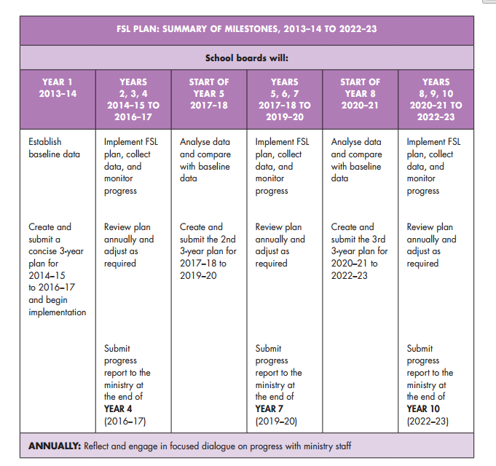
http://www.curriculum.org/storage/30/1370607618/FSL-module-3.pdf

